Slide 1

CRISA Customer Segmentation
C Meyer
MIS-64060 Machine Learning
Spring 2021

Slide 2
Market Segmentation
What are our customers buying? Why?
Are our customers loyal to any brand(s)?
What proposition categories appeal to them?

Slide 3
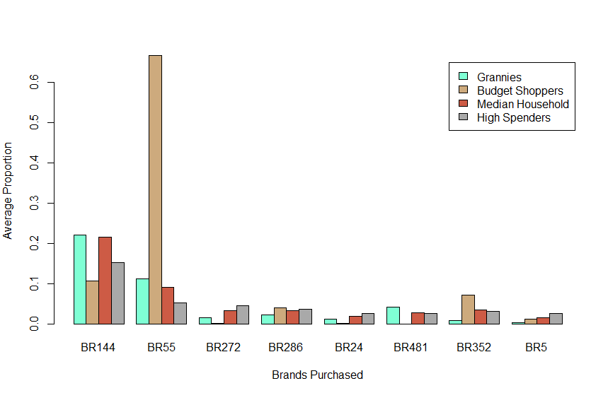
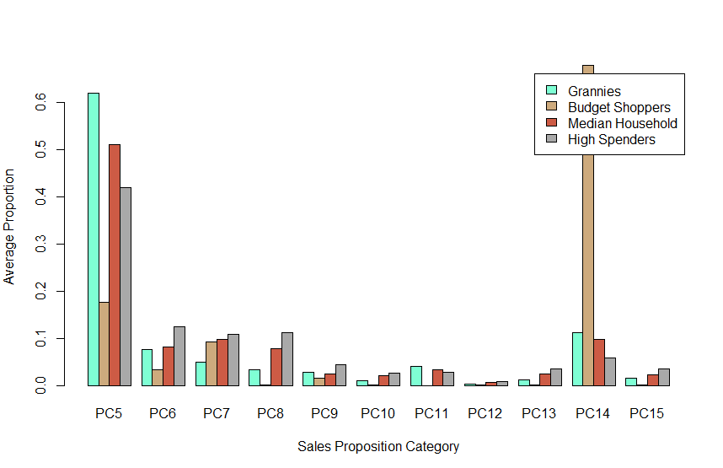
Brands
Propositions

Slide 4
Segment-Based Strategies
Customer Segment Strategies
 | Median Households (n=283) | High Spenders (n=215) | The Grannies (n=49) | Budget Shoppers (n=53)
Socioeconomic Class | Mixed | High-Medium | Medium-Low | Low
Price Category (Primary) | 2 | 2 | 2 | 3
Price Category (Secondary) | 1, 4 | 1 | 4, 3 | 2
Preferred Brand | 144 | 144 | 144 | 55
Brand Loyalty (Proportion) | 38% | 24% | 35% | 88%
Sales Proposition (Primary) | 5 | 5 | 5 | 14
Sales Proposition (Secondary) | 14, 7, 6, 8 | 8, 6, 7 | 14, 6, 7 | 5, 7

